Slide 1
Cryptography and Network Security
Electronic Mail Security
Notes:
1
Lecture slides by Lawrie Brown for “Cryptography and Network Security”, 4/e, by William Stallings, Chapter 15 – “Electronic Mail Security”.

Slide 2
Email Security
email is one of the most widely used and regarded network services
currently message contents are not secure
may be inspected either in transit
or by suitably privileged users on destination system
Notes:
2
In virtually all distributed environments, electronic mail is the most heavily used network-based application. But current email services are roughly like "postcards”, anyone who wants could pick it up and have a look as its in transit or sitting in the recipients mailbox.

Slide 3
Email Security Enhancements
confidentiality
protection from disclosure
authentication
of sender of message
message integrity
protection from modification
non-repudiation of origin
protection from denial by sender
Notes:
3
With the explosively growing reliance on electronic mail for every conceivable purpose, there grows a demand for authentication and confidentiality services. What we want is something more akin to standard mail (contents protected inside an envelope) if not registered mail (have confidence about the sender of the mail and its contents). That is, the “classic” security services listed are desired.

Slide 4
Pretty Good Privacy (PGP)
Pretty Good Privacy or PGP was a popular program used to encrypt and decrypt email over the internet, as well as authenticate messages with digital signatures and encrypted stored files.
widely used de facto secure email
developed by Phil Zimmermann
selected best available crypto algs to use
integrated into a single program
on Unix, PC, Macintosh and other systems
originally free, now also have commercial versions available
Notes:
4
The Pretty Good Privacy (PGP) secure email program, is a remarkable phenomenon, has grown explosively and is now widely used. Largely the effort of a single person, Phil Zimmermann, who selected the best available crypto algorithms to use & integrated them into a single program, PGP provides a confidentiality and authentication service that can be used for electronic mail and file storage applications. It runs on a wide range of systems, in both free & commercial versions.

Slide 5
PGP Operation – Authentication
sender creates message
use SHA-1 to generate 160-bit hash of message
signed hash with RSA using sender's private key, and is attached to message
receiver uses RSA with sender's public key to decrypt and recover hash code
receiver verifies received message using hash of it and compares with decrypted hash code
Notes:
5
The actual operation of PGP consists of five services: authentication, confidentiality, compression, e-mail compatibility, and segmentation.
Here see the digital signature service provided by PGP, using the steps as shown. Note this assumes use of RSA digital signatures, recent PGP versions also support the use of DSS signatures. Signatures can also be detached from a message/file and sent/stored separately.

Slide 6
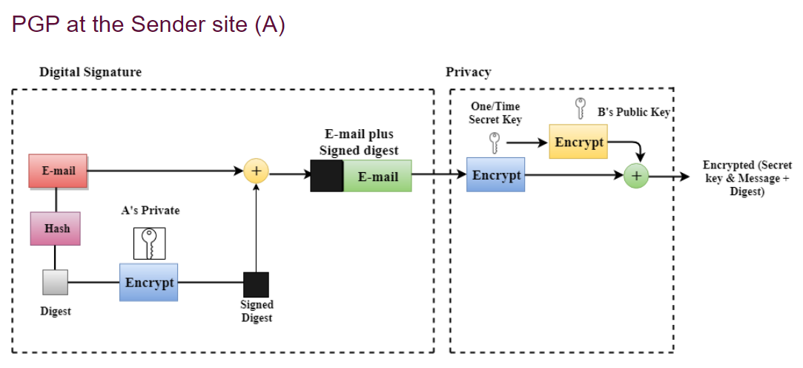

Slide 7
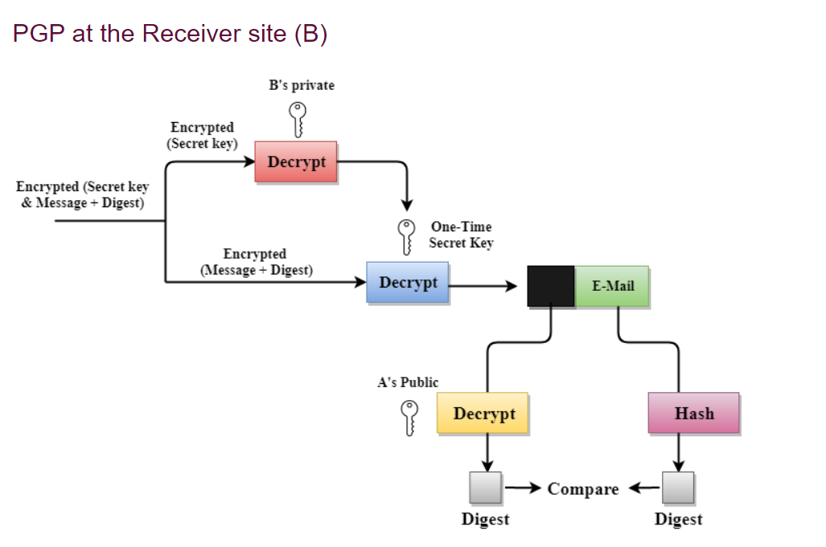

Slide 8
PGP Operation – Confidentiality
sender generates message and 128-bit random number as session key for it
encrypt message using CAST-128 / IDEA / 3DES in CBC mode with session key
session key encrypted using RSA with recipient's public key, & attached to msg
receiver uses RSA with private key to decrypt and recover session key
session key is used to decrypt message
Notes:
8
Another basic service provided by PGP is confidentiality, provided by encrypting messages to be transmitted or to be stored locally as files, using symmetric encryption algorithms CAST-128, IDEA or 3DES in 64-bit cipher feedback (CFB) mode. The randomly chosen session key used for this is sent encrypted using the recipient’s public RSA key. The steps used in this process are as shown. Recent PGP versions also support the use of ElGamal (a Diffie-Hellman variant) for session-key exchange.

Slide 9
PGP Operation – Confidentiality & Authentication
can use both services on same message
create signature & attach to message
encrypt both message & signature
attach RSA/ElGamal encrypted session key
Notes:
9
Both confidentiality & authentication services may be used for the same message. Firstly a signature is generated for the plaintext message and prepended to the it. Then the plaintext message plus signature is encrypted using CAST-128 (or IDEA or 3DES), and the session key is encrypted using RSA (or ElGamal).

Slide 10
PGP Operation – Compression
by default PGP compresses message after signing but before encrypting
so can store uncompressed message & signature for later verification
& because compression is non deterministic
uses ZIP compression algorithm
Notes:
10
By default PGP compresses the message after applying the signature but before encryption. This has the benefit of saving space both for e-mail transmission and for file storage. The signature is generated before compression for the reasons shown. The compression algorithm used is ZIP, which is described in Stallings Appendix 15A.

Slide 11
PGP Operation – Email Compatibility
when using PGP will have binary data to send (encrypted message etc)
however email was designed only for text
hence PGP must encode raw binary data into printable ASCII characters
uses radix-64 algorithm
maps 3 bytes to 4 printable chars
also appends a CRC
PGP also segments messages if too big
Notes:
11
When PGP is used, at least part of the block to be transmitted is encrypted, and thus consists of a stream of arbitrary 8-bit octets. However many electronic mail systems only permit the use of ASCII text. To accommodate this restriction, PGP provides the service of converting the raw 8-bit binary stream to a stream of printable ASCII characters. It uses radix-64 conversion, in which each group of three octets of binary data is mapped into four ASCII characters. This format also appends a CRC to detect transmission errors. See Stallings Appendix 15B for a description.
PGP also automatically subdivides a message that is too large for a single email, into segments that are small enough to send.

Slide 12
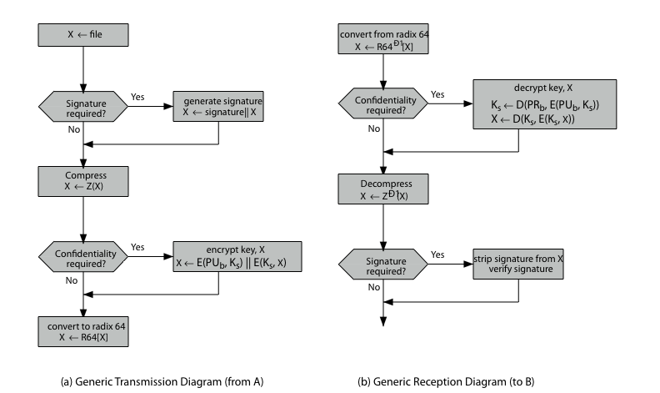
PGP Operation – Summary
Notes:
12
Stallings Figure 15.2 illustrates the general operation of PGP, and the relationship between the services discussed.

Slide 13
PGP Session Keys
need a session key for each message
of varying sizes: 56-bit DES, 128-bit CAST or IDEA, 168-bit Triple-DES
generated using ANSI X12.17 mode
uses random inputs taken from previous uses and from keystroke timing of user
Notes:
13
PGP makes use of four types of keys: one-time session symmetric keys, public keys, private keys, and passphrase-based symmetric keys.
Each session key is associated with a single message and is used only for the purpose of encrypting and decrypting that message. Random numbers are generated using the ANSI X12.17 generator, with inputs based on keystroke input from the user, where both the keystroke timing and the actual keys struck are used to generate a randomized stream of numbers. Stallings Appendix 15C discusses PGP random number generation techniques in more detail.

Slide 14
PGP Public & Private Keys
since many public/private keys may be in use, need to identify which is actually used to encrypt session key in a message
could send full public-key with every message
but this is inefficient
rather use a key identifier based on key
is least significant 64-bits of the key
will very likely be unique
also use key ID in signatures
Notes:
14
Since many public/private keys may be in use with PGP, there is a need to identify which key is actually used to encrypt the session key for any specific message. You could just send the full public-key with every message, but this is inefficient. Rather PGP use a key identifier based on the least significant 64-bits of the key, which will very likely be unique. Then only the much shorter key ID would need to be transmitted with any message. A key ID is also required for the PGP digital signature.

Slide 15
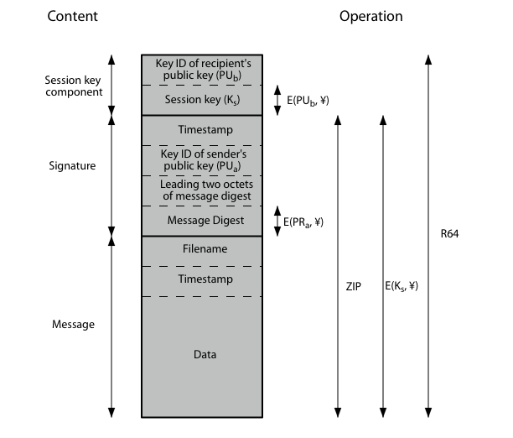
PGP Message Format
Notes:
15
Stallings Figure 15.3 shows the format of a transmitted PGP message. A message consists of three components: the message component, a signature (optional), and a session key component (optional).

Slide 16
PGP Key Rings
each PGP user has a pair of keyrings:
public-key ring contains all the public-keys of other PGP users known to this user, indexed by key ID
private-key ring contains the public/private key pair(s) for this user, indexed by key ID & encrypted keyed from a hashed passphrase
security of private keys thus depends on the pass-phrase security
Notes:
16
Keys & key IDs are critical to the operation of PGP. These keys need to be stored and organized in a systematic way for efficient and effective use by all parties. PGP uses a pair of data structures, one to store the users public/private key pairs - their private-key ring; and one to store the public keys of other known users, their public-key ring. The private keys are kept encrypted using a block cipher, with a key derived by hashing a pass-phrase which the user enters whenever that key needs to be used. As in any system based on passwords, the security of this system depends on the security of the password, which should be not easily guessed but easily remembered.

Slide 17
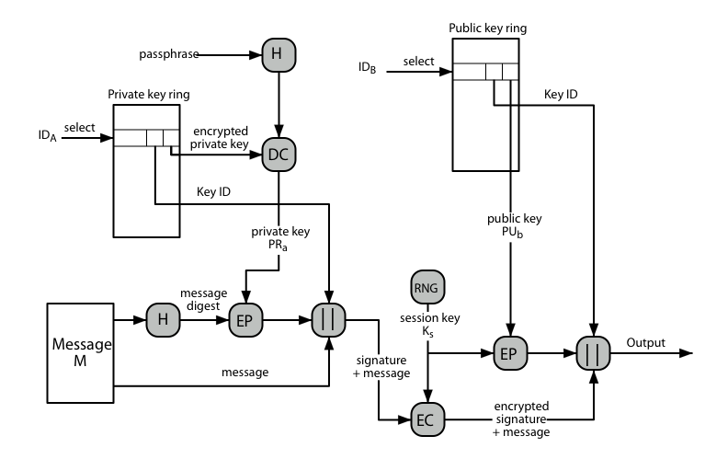
PGP Message Generation
Notes:
17
Stallings Figure 15.5 illustrates how these key rings are used in message transmission to implement the various PGP crypto services (ignoring compression and radix-64 conversion for simplicity).

Slide 18
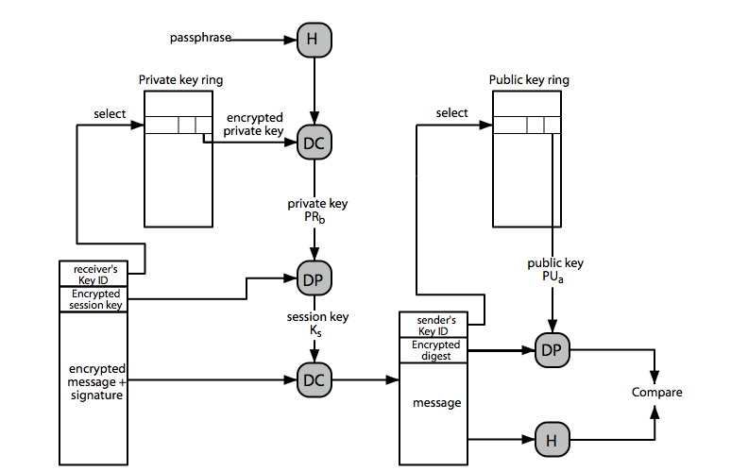
PGP Message Reception
Notes:
18
Stallings Figure 15.6 then illustrates how these key rings are used in message reception to implement the various PGP crypto services (again ignoring compression and radix-64 conversion for simplicity).

Slide 19
PGP Key Management
rather than relying on certificate authorities
in PGP every user is own CA
can sign keys for users they know directly
forms a “web of trust”
trust keys have signed
can trust keys others have signed if have a chain of signatures to them
key ring includes trust indicators
users can also revoke their keys
Notes:
19
The PGP documentation notes that “This whole business of protecting public keys from tampering is the single most difficult problem in practical public key applications”. Its solution is to support a variety of formal and informal environments, in which any user can act as a “CA” to certify another user’s public key, and then act as a “trusted introducer” to other users, thus forming a “web of trust”. PGP provides a convenient means of using trust, associating trust with public keys, and exploiting trust information. The key ring is regularly processed to derive trust indicators for keys in it.
PGP allows a user to revoke their current public key, either because compromise is suspected or simply to avoid the use of the same key for an extended period.

Slide 20
S/MIME (Secure/Multipurpose Internet Mail Extensions)
security enhancement to MIME email
original Internet RFC822 email was text only
MIME provided support for varying content types and multi-part messages
with encoding of binary data to textual form
S/MIME added security enhancements
have S/MIME support in many mail agents
eg MS Outlook, Mozilla, Mac Mail etc
Notes:
20
S/MIME (Secure/Multipurpose Internet Mail Extension) is a security enhancement to the MIME Internet e-mail format standard, which in turn provided support for varying content types and multi-part messages over the text only support in the original Internet RFC822 email standard. MIME allows encoding of binary data to textual form for transport over traditional RFC822 email systems. S/MIME support is now included in many modern mail agents.

Slide 21
S/MIME Functions
enveloped data
encrypted content and associated keys
signed data
encoded message + signed digest
clear-signed data
cleartext message + encoded signed digest
signed & enveloped data
nesting of signed & encrypted entities
Notes:
21
In terms of general functionality, S/MIME is very similar to PGP. Both offer the ability to sign and/or encrypt messages. S/MIME provides the functions shown.

Slide 22
S/MIME Cryptographic Algorithms
digital signatures: DSS & RSA
hash functions: SHA-1 & MD5
session key encryption: ElGamal & RSA
message encryption: AES, Triple-DES, RC2/40 and others
MAC: HMAC with SHA-1
have process to decide which algs to use
Notes:
22
S/MIME uses a range of cryptographic algorithms, as shown.
The S/MIME specification includes a discussion of the procedure for deciding which content encryption algorithm to use, based on the capabilities of all parties.

Slide 23
S/MIME Messages
S/MIME secures a MIME entity with a signature, encryption, or both
forming a MIME wrapped PKCS object
have a range of content-types:
enveloped data
signed data
clear-signed data
registration request
certificate only message
Notes:
23
S/MIME secures a MIME entity with a signature, encryption, or both. A MIME entity may be an entire message or one or more of the subparts of the message. The MIME entity plus some security related data, such as algorithm identifiers and certificates, are processed by S/MIME to produce a PKCS, which refers to a set of public-key cryptography specifications issued by RSA Laboratories. A PKCS object is then treated as message content and wrapped in MIME. Have a range of S/MIME content-types, as shown.

Slide 24
S/MIME Certificate Processing
S/MIME uses X.509 v3 certificates
managed using a hybrid of a strict X.509 CA hierarchy & PGP’s web of trust
each client has a list of trusted CA’s certs
and own public/private key pairs & certs
certificates must be signed by trusted CA’s
Notes:
24
S/MIME uses public-key certificates that conform to version 3 of X.509 (see Chapter 14). The key-management scheme used by S/MIME is in some ways a hybrid between a strict X.509 certification hierarchy and PGP’s web of trust. S/MIME managers and/or users must configure each client with a list of trusted keys and with certificate revocation lists, needed to verify incoming signatures and to encrypt outgoing messages. But certificates are signed by trusted certification authorities.

Slide 25
Certificate Authorities
have several well-known CA’s
Verisign one of most widely used
Verisign issues several types of Digital IDs
increasing levels of checks & hence trust
Class Identity Checks Usage
1 name/email check web browsing/email
2 + enroll/addr check email, subs, s/w validate
3 + ID documents e-banking/service access
Notes:
25
There are several companies that provide X.509 certification authority (CA) services. Of these, the most widely used is the VeriSign CA service. VeriSign issues X.509 certificates known as Digital IDs. VeriSign provides three levels, or classes, of security for public-key certificates, with increasing levels of checks & hence trust, as shown above, and in Stallings Table 15.8.

Slide 26
Summary
have considered:
secure email
PGP
S/MIME
Notes:
26
Chapter 15 summary.

